Slide 1
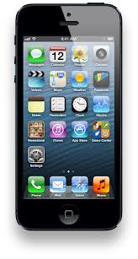
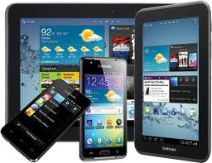
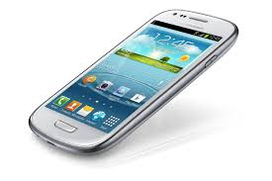
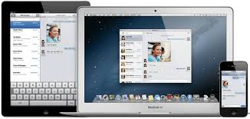
Apple Vs. Samsung
By: Lin Choi, Grace Yang, Alexis Aguiar, Manas Joshi, and Bryan Li

Slide 2
Let us introduce…………..
THE APPLE VS. SAMSUNG GROUP!
The Apple vs. Samsung group would like to present a powerpoint based on how these companies treat their workers. And we are presenting a powerpoint that shows people how these companies treat their workers and how they are similar or different. Now…..without further ado give a big round of applause for the (drumroll) APPLE VS. SAMSUNG GROUP!!!

Slide 3
Facts on iPhones and Other Apple Products
Apple device screens are made of a glass that usually breaks easily if you drop it.
Apple device cases are made from blue-prints on hand.
The people who make the iPhones or iPhone cases work in factories and work 10 hours to get only $8 in China and $34 in Korea.
Apple devices are very dangerous to make.
Some other Apple products are also made dangerously in factories
Apple iPhones are used in countries all around the world.
iPhones have a glass cover above the screen to prevent damage to the inside of the screen.
Apple never lowers the price of it’s products. The reason you can get them for cheap is because other companies buy them and then sell them for lower or higher prices.

Slide 4
How are iPhones made?
iPhones are made by putting together many parts like glass and other hazardous to use. They are very dangerous to make, since they contain many parts that can explode very easily.
iPhones are also dangerous because the technology is supposed to be perfect but it isn’t.
iPhones should stop letting sweatshop workers assemble the parts and sometimes are exclusively made in China as in sweatshops and the Chinese government agents are supporting this business because they think this is fair but it isn’t.
Chinese government thinks that if the people who do not work in sweatshops care so much about the people working in sweatshops the people should write letters and do it on their own but the Chinese government shouldn’t be supporting the business anyway.
And China’s government doesn’t seem to be doing anything about it,
The chinese government is supporting the business like the sweatshops. The chinese government thinks that they should be kept like this because they think that it is right..

Slide 5
How are Samsung products made?
Samsung phones such as Galaxies are made in factories that work with high tech things that are really dangerous.
Samsung phones have high tech parts and some internet connections that might have some terrible risks. Like if something goes wrong with the high tech part like that disk in the phone that makes it function might explode and cause a fire. And if some work is not done, the people responsible for the shop might lock all the exits and keep the workers inside which leaves the workers no choice but to burn.
Also, sweatshop workers have to design and make the most powerful part of the device, which happens to be the disk that may explode.
Samsung products have a removable battery source, which means that you can change the battery unlike Apple products, which you have to break open or use a screwdriver.

Slide 6
How are the people who make Apple products treated?
Apple products are made in China and they are being treated very harshly.
They are making their workers work 12-14 hours a day and they are paying them only a few dollars. Eight dollars in China and thirty-four dollars in Korea per device to be exact.
Also, the conditions they work in is horrible. They have to work in big factories that don’t even have heating or air conditioning.
The workers are being forced to work for a long time and they have to do quality work or they don’t get payed as much.
The people in China and Korea are suffering a lot since they have to do so much work.

Slide 7
So, Why Can’t They Stop Working In These Factories?
Many people working in these factories have no other choice. They don’t have any other job to work in and need the money. Unfortunately, they are just encouraging sweatshop labor and have no other choice. Since there is no other choice, nobody can help them. Nobody, but us. There are very little jobs offered in China, but even if one is better than sweatshops, many people don’t qualify for the jobs. Sweatshops are almost at the very bottom of the list, and lots of people end up in these dangerous factories where they barely get paid. They have no choice. As most people say, it is better to have very little of something, than to have nothing at all. Well, sweatshop workers prove them right. They need all the money they can get to support their families as much as possible. They need all the money they can get to at least survive.

Slide 8
Problems With China and Korea
China’s Problem
China’s economy is stepping up quickly into first place in the world. So, why do people need to work in these factories with so little money? While China’s economy may be growing to be the best in the world, the economy’s balance is just TERRIBLE. In some parts of China, especially in large cities, people have the privilege to get rich. Many people can have an amount equal to $10 trillion! Phew! That is a lot of money! In other parts of China, especially in rural areas away from cities, people have no money, have to hike long distances to get water, and cannot grow crops due to very rocky land.
North Korea’s Problem
North Korea’s economy is a very well built system. Even if their economy is still growing, doesn’t mean that the people in it are still. Since the 1900’s, North Korea has been through famine many times through. This is the exact reason why parents and some underaged ‘students’ are risking their lives for money, food and each other. They fight to get food each and every day due to those who are greedy. Maybe some are filthy rich but they just don’t want to share their profits with others but others just might be middle-classed but they are still donating and contributing to their neighbors.

Slide 9
But isn’t this illegal?
The reason why these people working in these situations it is because they need more money.
The Chinese government thinks that if the people really care then they should send letters and make it stop when they have all the power to do what they want the workshops to do. Until we do, they will become more and more powerful.
The sweatshop workers should arouse their economy by protesting and maybe going on a strike. But remember they can’t. The bosses of these sweatshop workers are greedily taking advantage of this point of view.

Slide 10
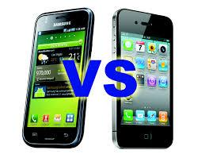
HOPE YOU ENJOYED THIS Presentation!!
>_<

