Slide 1
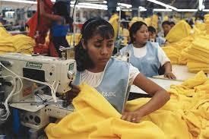
By: Ethan Huang, Jennifer Dresner, Joyce Lin, and Rajvir Gill

Slide 2
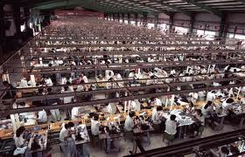
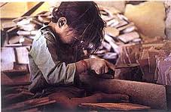
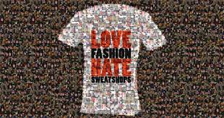
Introduction To Sweatshops
Sweatshop, sweatshop, sweatshop. What is a sweatshop? A sweatshop is a factory or workshop in the clothing industry workers are paid at low wages, and bad conditions. SO in this presentation, we are going to show you some clothing companies that have sweatshops. Do you know the company “Abercrombie and Fitch?” Well you know the owner of “Abercrombie and Fitch,” told the news that the clothing that they make are only for skinny people. Also you know what else, “Abercrombie and Fitch,” use sweatshops. Can you imagine that? A very famous company with all of that trouble? Well “Abercrombie and Fitch,” isn’t the only company that uses sweatshop. There are still many more companies that use sweatshops.
Probably not all of the companies use sweatshops. The big companies like “Gap,” use sweatshops. Do you know that buying these types of clothes can encourage sweatshop. Do you really want people dying just for making clothes. Do you know that in sweatshops, many people die due to the terrible environment that the workers have to work in. Sweatshops are all around the world, and you never know what will happen.

Slide 3
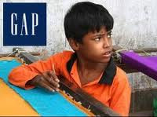
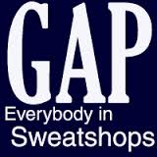
Gap
Gap is a great company, but do you know what the people working have to go through? Well people found ten year olds making Gap clothes at a Gap factory. Can you believe that? Ten year olds make clothes. Another thing that happened is that 3 people died because they had to work even if they were really ill. Well, companies that have factories like these are called sweatshop. Gap is one of them, and Gap is known to have at least one sweatshop in 6 different countries. A reporter Dan McDougall found out and said that the children were working without pay as slaves in bad conditions, with a single bowl of rice covered with flies. They also slept on the roof. As you can see, people like the CEO do many things that you don’t think they do to their own workers that are still children.
Notes:
Joyce you didn’t write enough

Slide 4
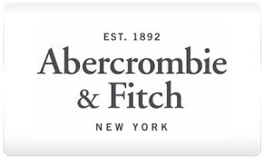
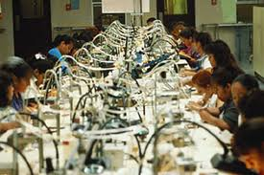
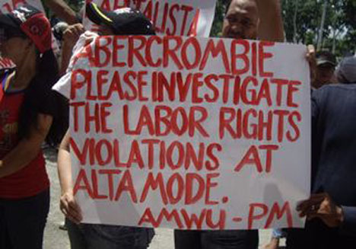
Abercrombie and Fitch
What do you think when you hear someone say “Abercrombie and Fitch”? Do you think “Hey isn’t that a clothing company?” “Why is someone talking about it?” Well you should think about it, because Abercrombie and Fitch has sweatshops. People are given cotton balls, and make 38 cents for every 10 kg of clothes they make. How would you feel if you make 10 kg of clothes, and then you only get paid 38 cents, and you worked so hard? Would you like to earn barely any money from making lots of clothes? Do you really want people dying just to make clothes for you?
Think about it, the boss of “Abercrombie and Fitch,” even announced that he only wanted cool and skinny people to wear his clothes. Can you believe that? The clothes were made just for certain types of people. That is not cool, and doing that is like saying, “Hey, I don’t like you, I don’t want you wearing those clothes.” Wait, that is exactly what the boss of “Abercrombie and Fitch,” is trying to say. Do you know now how bad this famous company can be? What will you do now that you read this?

Slide 5
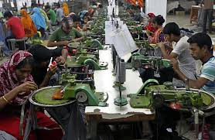
Sears
Some people might think that Sears is a great store. Well it sort of is but they also use sweatshop labor. People who work for Sears get paid 29 cents per clothing piece. How would you feel if you got paid 29 cents for every clothing you make. Besides pay these sweatshop labor workers have to work in bad conditions such as if they are sick they still have to come and make clothing, sometimes they even die. These are not conditions people should be working in. It is not right for humans. Everyone should always be treated the same way. Their should not be the words poor or rich, their should only be the word human.
People should be treated like regular people. Sweatshops are terrible, because people work in dangerous conditions. When people are treated more fairly, than they would get better payments for their clothes. If Sears is making it where people are barely paid enough money to live, that is not right for men and women! When people are treated fairly at any sweatshop, than that is right and that is fair to the people working and the people paying the workers.

Slide 6
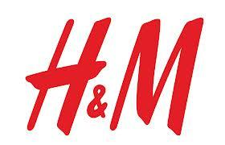
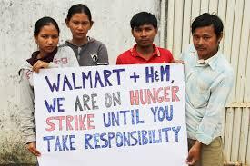
H&M
H&M is a very popular clothing company. The sell many clothes and they also make a lot of money. Many people buy clothes made from that company. They think that the clothes are cheap and in fashion. What they don’t know is that H&M supports sweatshop labor. In early October 2013 there were some reports that a worker leave from work unconscious, and very ill. After an investigation was launched on the topic, other workers revealed that they too, often blacked out at work due to hazardous work conditions. In an interview with Junior Scholastic H&M said that they were working hard to prevent this issue from happening again.
If you ever wondered how H&M can afford to sell their name brand clothing for so little, that is because of sweatshop labor. When companies use sweatshop labor, they make their clothing for much cheaper because they do no need to spend as much money making them as they would in America. If they sell their clothes cheaper, more people will want to buy the clothes because they are popular and affordable. However, I think that companies are trying to stop using sweatshop labor is because of bad publicity, not because they care about the sweatshop workers.
Notes:
x

Slide 7
Joyce’s Response
When I started researching for this project, the first thing I saw was that a reporter Dan McDougall found out and said that the children were working without pay as slaves in bad conditions, with a single bowl of rice covered with flies. They also slept on the roof. I was so surprised is that even once when I went to a place that banned meat, the worst thing that I tasted must have been much better than eating ONLY a single bowl of rice covered with flies!! I feel so guilty, that now, I don’t want to buy clothes. Usually, I just wear clothes that older friends used to wear, and they are still perfectly fine, and I don’t need to buy things that are new all the time.
I feel very bad for the people that make these clothes. I wish that CEO’s would think about what would happen if they worked in a sweatshop, and only earned 52 cents (in Cambodia), and they worked in poor conditions. I think that using children to make clothes is just plain evil. CHILD LABOR!!! I learned a lot about how big companies like Gap, H&M, Abercrombie and Fitch, and etc.
I want to notify everyone that if you want to do something to help stop these companies from using child labor, and sweatshops, you can try doing things like boycotting. I know people that donated food to China for people who were poor, and before, I didn’t really care or even think about it, but now, I am very glad that people are helping others.

Slide 8
Rajvir’s Response
Sweatshops has been around for a while now and are unfair to some people, and the fact that some people know and don’t do anything about is unbelievable. We kill people for our clothes and don’t even care. People who work for some companies get paid 12 cents per clothing piece. How would you feel if you got paid 12 cents for every clothing you make. Besides pay these sweatshop labor workers have to work in bad conditions such as if they are sick they still have to come and make clothing, sometimes they even die. These are not conditions people should be working in. It is not right for humans. Everyone should always be treated the same way. Their should not be the words poor or rich, their should only be the word human.The real cost of clothes isn’t money, it’s lives.

Slide 9
This project was about sweatshop labor. At first I didn’t really understand why we needed to do this project, but then I started researching. Then I understood the purpose of the project. Of course we could have just researched the topic, writing about the topic was one of the best topics I ever wrote about. It didn’t take any time at all to write the information about H&M. The topic was very easy to write off of because I have a lot to say about it. I guess that is what happens when you have a writing topic that you like a lot. I loved this project, and the people in my group said that they liked it too.
This issue about sweatshop labor really upsets me. In America, if a child is kidnapped or abused, the person responsible is sentenced to life in prison. The people behind sweatshops and child labor are basically doing the same thing. They endanger the welfare of a child, they give them unsafe working conditions that might kill them in fires or if the building itself collapsed like it did in Bangladesh recently. I don’t know why the people in charge of these companies using sweatshop labor don’t face criminal charges. These countries need to get laws against this.
This project was fun for me. The writing was very motivating and I know that the topic was very interesting for me.

Slide 10
Ethan’s Response
When I first saw this project, I wanted to do something else, but I couldn’t so I was stuck with this topic. Well it turns out this topic was great. After this project I learned so much about clothing brands and many things that were disturbing. I can’t believe that all these famous clothing brands were actually using sweatshop labor. So now I have to be careful about what kind of clothes my mom buys for me and if I want to wear them.
I learned that children and adults are making clothes, and getting paid with low money per pair. I learned that the workers in America would be paid more to make the same kind of pair of clothing that would be made in Bangladesh. That is terrible, and some of the workers lost their lives because of the dangerous environment, and the unstable building. Over 1,000 people lost their lives in a sweatshop because the building collapsed.
So one famous company that sold cheap clothes and I saw my cousins wearing and shopping at was Abercrombie and Fitch. My mom always said that Abercrombie and Fitch had cheap clothing and I didn’t mind, until last year. Last year, I learned that the founder of Abercrombie and Fitch made the clothes for the “cool and skinny” people, and he didn’t change that ever since it was on the news. So now I don’t feel comfortable wearing clothes that came from sweatshops and were meant for the “cool and skinny” people. People should start to put an end to sweatshops.

Slide 11
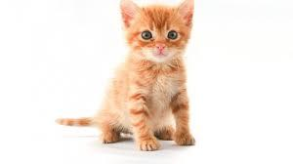
Why Sweatshop Labor is Wrong
You probably know by now that sweatshop labor is wrong. You probably think that it is illegal or something. You don’t know why. People don’t explain why. You just hear people say that sweatshop labor is wrong. There is no explanation for it. Well, sweatshop labor is wrong. There are many reasons why. Companies use sweatshop labor in order to produce their products cheaper and still make a profit. because consumers aim to buy cheaper clothing. The cheaper the clothes are, the more people will buy the clothes. Good for the company and the consumer, right? Wrong. Companies can afford to sell their clothes at cheaper prices because they are using sweatshop labor, which is a factory in the clothing industry, and workers are paid at low prices, and working in bad conditions. This is wrong because they are treated as prisoners to the factories. in fact, they companies don’t even care about their workers. For example, recently a sweatshop in India has a five alarm fire. The company didn’t provide any fire escapes for the workers and more than two hundred workers died. Letting many lives be taken away at your own risk is wrong. Therefore, sweatshop labor is wrong.

Slide 12
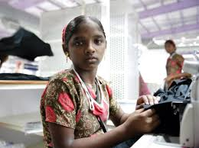
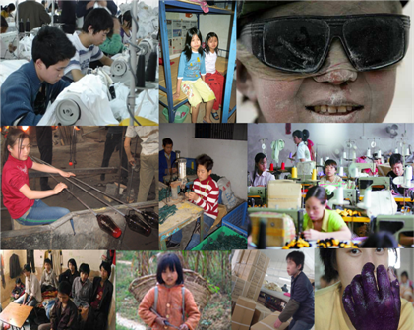
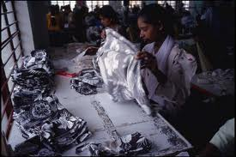
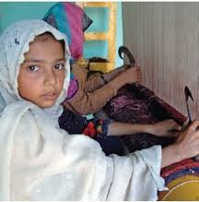
HELP US!!!

Slide 13
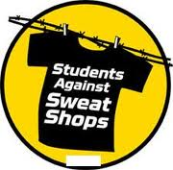
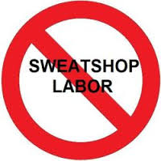
Thanks For Watching And Remember!
We want to put an end to sweatshop labor!

