Slide 1



Slide 2

Introduction
Everyone loves Hershey's, the sweet creamy chocolatey taste, the varieties which include Dark chocolate, Milk chocolate, and White chocolate. YUMMY!!! Have you ever wondered how to make these delicious treats? Well, these treats are created in factories. But who works in these factories to create Hershey chocolates?
All everyone thinks are these delicious, bars and candy. In those Hershey's store, everyone buys it for what it tastes like. But, do they think about how it’s made in the beginning? Do they know how these awesome things are made?

Slide 3
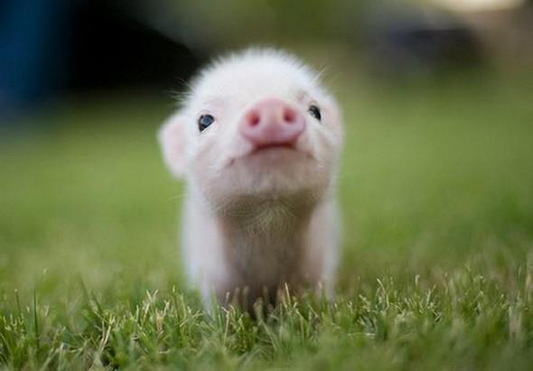
What’s the Story?
As you can see, we were surprised that Hershey’s chocolates are using child labor by making kids get the cocoa beans from the plant. This is happening in Africa and we think barely anyone is paying attention in stores. There are these delicious treats that are using child labor and probably none of the customers know. All of these chocolates are taken because of they are the tastiest and the sweetest products made.

Slide 4

In 1893, Milton Hershey (the founder of Hershey’s) went to the Chicago where he bought a chocolate-making machine. With that, he had made chocolate-coated caramels. In 1894, he started the Hershey Company and made Hershey’s chocolate, caramels, breakfast cocoa, sweet chocolate and baking chocolate. He sold his caramel business and concentrated on chocolate-making. Until he became a success in the world of chocolate!

Slide 5

Who Has Been Involved in My Existence?
Hersheys are made by kids. I know that it is unbelieveable, but it is true. Kids are making these delicious treats for us. But these kids aren’t happy making them. They are trapped and being forced to make the Hersheys’ chocolates. They are earning a few cents per hour. They probably have no choice, but to stay in the factories until they bleed just to work to make money to support their families. So the kids are doing a lot for just a few cents per day and they

Slide 6
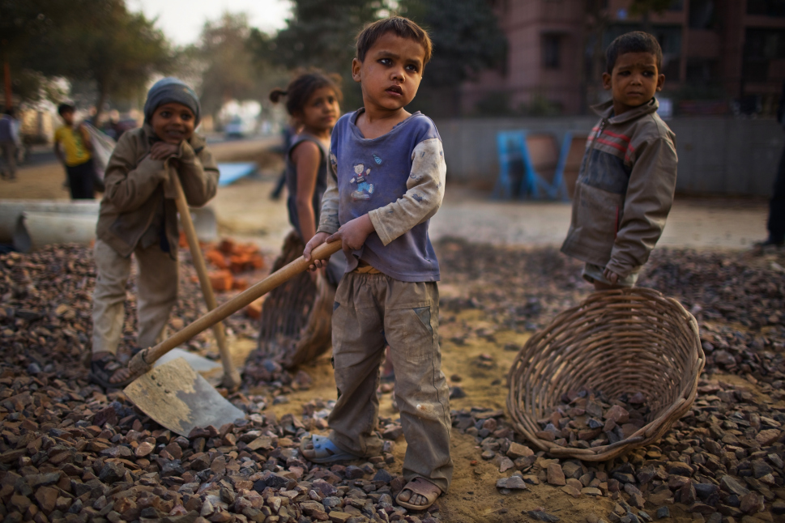
Who or what (people, animals, environment) was harmed for me to get to you right now?
We can’t believe it. But sadly, it’s true, Hersheys company is using CHILD LABOR to make their chocolates. First they have to pick the cocoa beans and grind them until they are ready in the west of Africa. After all the ingredients are put together the kids have to make the chocolate. Then it’s ready to go and is shipped to Hershey’s company. What the Hershey’s people do is sell the chocolate to other stores so they can sell it to us. And we eat it innocently while the kids that made it are starving and trapped. Do you think that it’s fair for little kids like us to work hard so we can enjoy?

Slide 7

Who or what (people, animals, environment) was harmed for me to get to you right now? (Continued)
Hershey’s uses children to make their chocolates and those children were put in hazardous conditions just so I could get to you. Believe it or not but your favorite chocolate brand uses child labor. Though in October of 2012, Hershey’s responded to hundreds of people pestering them for Fair Trade by announcing that they would stop at 2020.

Slide 8
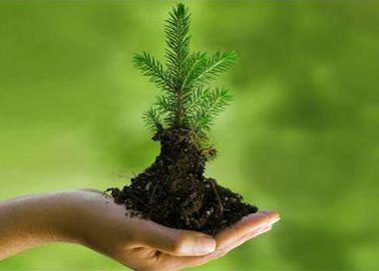
Were there ways for your item to be produced that would be less harmful to the environment, animals or people?
Investigate if there are similar items that may be less harmful to the environment, people and animals. (EX: More eco friendly companies that employ fair labor practices). Provide a reasonable alternative to this product.
Hershey’s can be less harmful and not use child labor. When they get their cocoa powder, which they get because of child labor, they can use something else that doesn't harm people.it’s like they make people do things for them, but not vise versa.

Slide 9
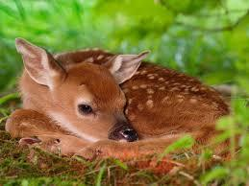
Were there ways for your item to be produced that would be less harmful to the environment, animals or people? (continued)
These chocolates or any tasty treats can be made with another object such as a crusher or anything that DOESN'T harm any humans! Finding another company we can use instead of Hershey’s is very hard. First of all, we love chocolate, but second of all, lots of companies use child labor to make chocolate. For example, not only does Hershey’s use child labor, but the company of Crunch, which including Nestle, also uses child labor also (surprisingly).

Slide 10

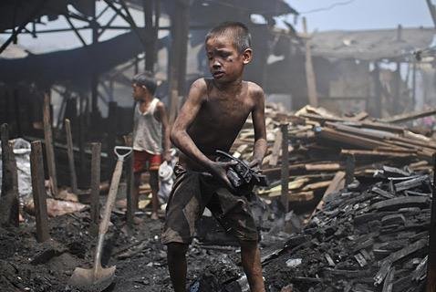

Slide 11

So we can conclude that people not aware of what is going on around that Hershey’s, the great tasting “chocolate making” company is using child labor. I think this is a very strong topic and a very hard choice that Hershey’s made. This is a horrible problem going on (especially child labor for sure). And also kids could make a difference so go on ahead, write a letter, email or protest!!!!!!!!!!!!!!!!!!!!!!!!!!!!!!!!!!!!!!!!!!!!!!!!

