Slide 1
Lately in class 5-301 we have been exploring world situations for many kids like us. We learned about many devastating conditions the environment, animals, and humans are in.
We have been looking at some issues with Palm Oil. Recently, 2 girls from Girl Scouts found out that Palm Oil was used to make their delicious cookies. They were just absolutely devastated; they wanted to let people know. Those 2 brave girls from Girl Scouts were really angry because they knew Palm Oil was killing animals that live in the forest like Orangutans. The 2 girls got many people to sign their petition, even Jane Goodall.
Our class has done many projects to let people be aware of the actions that are going on around us. We had projects such as Orangutans, Gorillas, and Chimpanzee project. In this project, we researched each animal and watched a movie call Born to be Wild. We then wrote a response to the movie and made a Venn diagram, comparing and contrasting each animal. We are working on projects that study world issues. We were divided into 6 teams. The topics we worked on were iPhone (Sweatshops in China)/Samsung, Palm Oil, Water Bottles, Hershey’s Candy, Nike sneakers, and Gap (Child Labor).

Slide 3
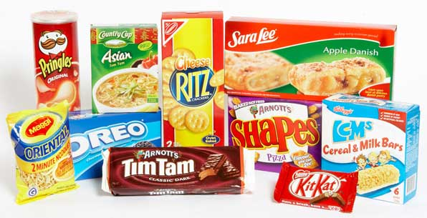
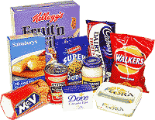
There are many more things to just eating whatever you want. For example. you ask your dad to go over to Dunkin’ Donuts and ask him for a chocolate donut with sprinkles. You are just supporting the fact that people should use palm oil which is bad. If you did not know that donuts use palm oil, then it would be news to you. Orangutans are suffering because people cut down trees that Orangutans live in to get palm oil. Donuts need palm oil and while we are having fun eating our favorite donuts, primates you were made from are getting close to extinction.
That is why people should not use palm oil. This is why good helping citizens around the world do not eat donuts even though they are their favorite snacks. Also, there are many other products or companies that use palm oil such as, Kit Kat, Pringles, Ritz, Cereal and Milk Bars and a lot more foods people favor too.

Slide 4
Palm Oil in General
Palm Oil is single-handedly destroying millions of trees which result in many deaths of primates. People don’t care, and that concerns me. There are LIVES out there that are dead, and many more are dying because of Palm Oil. So it’s not really the grease itself that is bad, but what it does. Now, I don’t want a company getting a whole bunch of protesters, even if they deserve it. I always loved Oreo’s and it pains me to see that they are mindlessly killing these monkeys. Just quit Palm Oil, and you’re free from being sued, or getting protesters at your front door.
From day one, I’ve thought Palm Oil was evil, and cruel to animals. Ever since I learned that Palm Oil was single-handedly murdering innocent apes, I knew it would be no good. Now look. It even has very famous companies under it’s control. If there is a company or 2 out there that have not been brainwashed, watch out for the poor orangutans! Come on Oreo’s. Snap out of your trance and come back to the side where you don’t have to kill defenseless animals!

Slide 5
When you eat a snack, you probably do not know the process it went through to be made. You might think that making these snacks are not a big deal to you, but they are to Orangutans around the world. People are cutting down trees in Borneo, Indonesia. Orangutans live there and their homes are being knocked down. Orangutans live in trees and their population is decreasing. Orangutans live in trees that carry palm oil. There will be many problems that will occur in these forests. Also, there are some people that do not care about the environment but only about their products. there are snacks that kids like and they are made out of palm oil. We need to stop cutting down trees. People do not care about what they do because it may not matter to them or to you. If you were one of the Orangutans, you would almost be homeless when people are cutting down trees. In the next 10 years, Orangutans will be extinct if we people do not follow the Palm Oil crisis. There would be many problems around the planet if Orangutans disappear. If they disappear, then a part of us will disappear as well. We were made from them, so if they go extinct, we might get into trouble too.

Slide 6
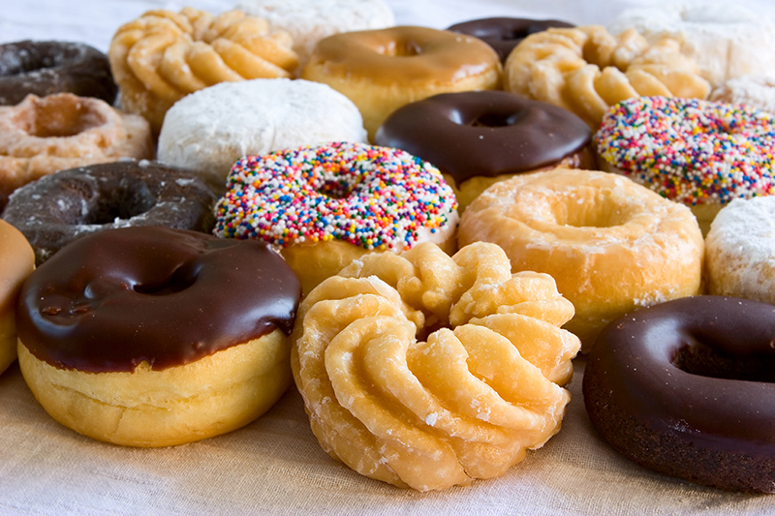
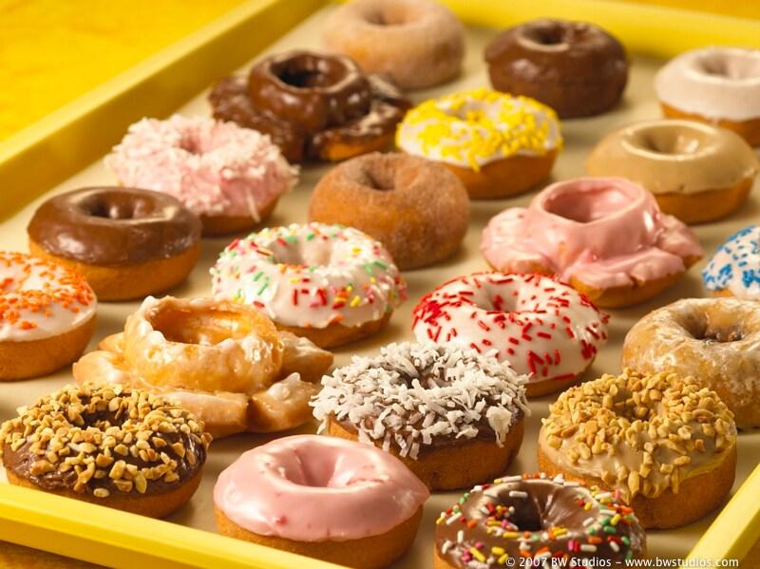
Do you love to eat donuts? Love it with cream or frosting? Well, donuts may make you feel good, but have you ever thought of how Orangutans feel? Lately, people have been noticing what Palm Oil has done to Orangutans. 2 little Girl Scouts started noticing that their delicious Girl Scout Cookies are hurting the orangutans, elephants, tigers and many more animals.
Recently, people have started to notice that dunkin donuts have used palm oil in their donuts. In fact, millions of products have been caught red-handed, using Palm Oil. Sadly, Dunkin Donut uses Palm Oil in their Donuts.
Dunkin Donuts have started to blend Palm oil with other oils like soy and cottonseed oil in it’s donuts since 2007. The New York State comptroller, Thomas P. DiNapoli states “Consumers may not realize that many of the foods and cosmetics they eat and use contain palm oil that has been harvested in ways that are severely detrimental to the environment.”
Will you boycott Dunkin’ Donuts? Or will you continue to eat Dunkin Donuts, while feeling guilty that you know that this food is killing orangutans?

Slide 7
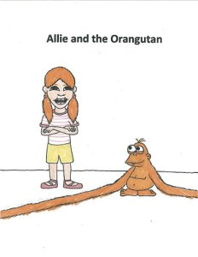
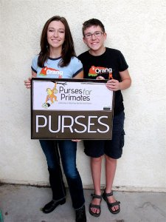
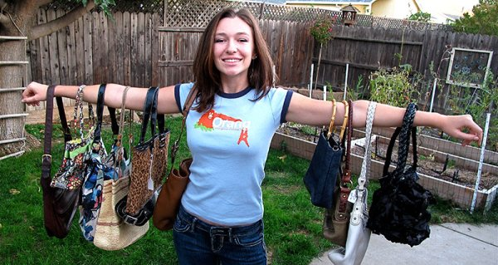
A girl named Allie Boyer also noticed that the orangutans habitat was being destroyed by evil people. She is helping by selling purses. “The funds we donate go directly to the releases of orangutans back into the wild from rehabilitation centers,” Allie says. She’s raised over $8,000 selling purses.“They help with all money given to us, making sure it gets to Orangutan Outreach,” Allie states.
Allie has noticed the Orangutans problem from when she was little.“When I was seven, and was first wanting to get into this cause, I emailed a bunch of different organizations. Rich took so much interest and it was amazing to me to find an adult that cared what a 7-year-old had to say. That is one of the reasons I donate 100% through them. Rich is definitely one of my heroes!” Allie says to North State Parents.
Allie states that Jane Goodall and Richard Zimmerman are her inspiration. “Jane, with her pure passion alone, got into her cause with chimpanzees and made a huge impact world wide, even though she started so small. And Rich has such a passion for saving orangutans that he quit his job at UNICEF just to start Orangutan Outreach. I hope that I can grow to be as successful with my cause as they are.”
“And if anyone is interested in hosting a purse party at their home, we do that too!” she says. “I find that getting more connections in my community goes a long way,” Allie adds. “Social media helps once you’re well known, but personal connections go very far.”

Slide 8
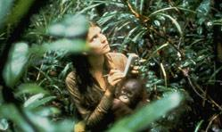
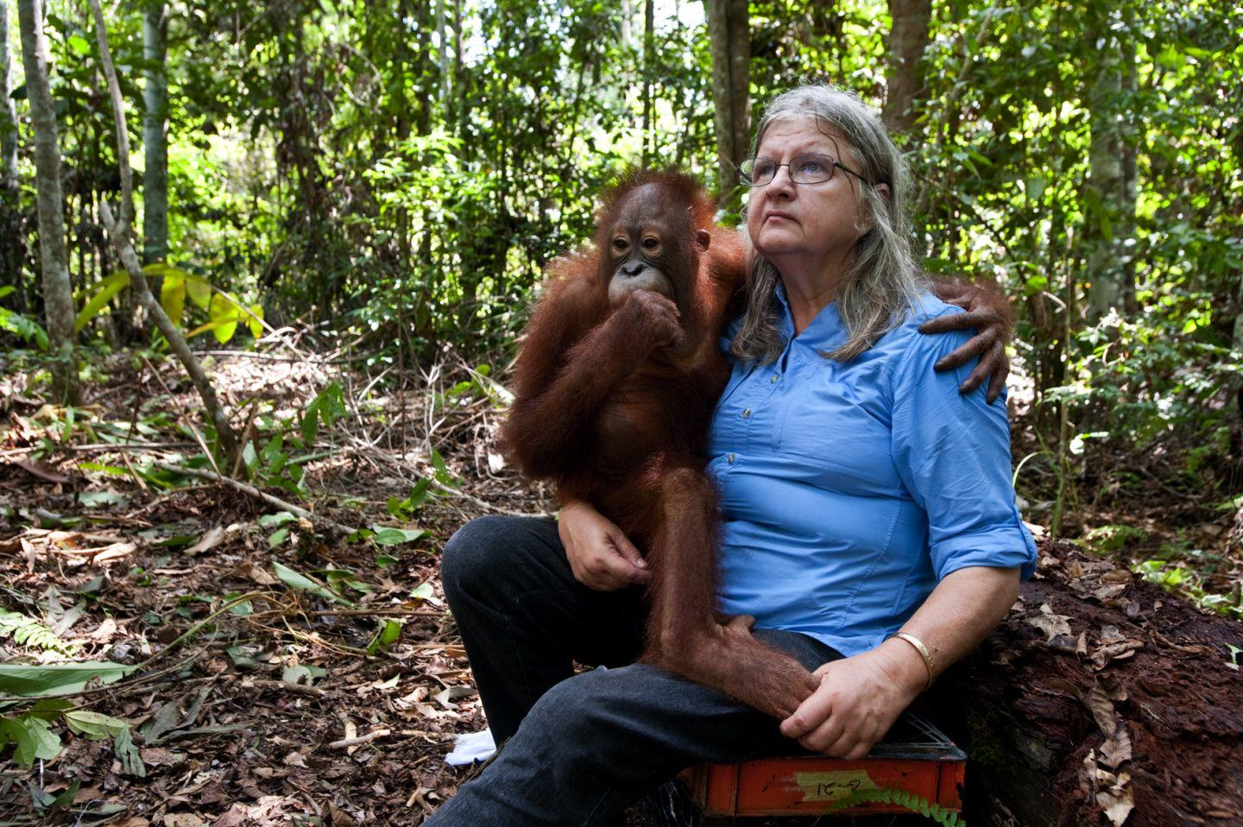
Birute Marija Filomena Galdikas
Birute Marija Filomena Galdikas who isn’t as famous, and works with orangutans, as Jane Goodall who worked with chimpanzees, and Diane Fossey who worked with gorillas, but this doesn’t mean that she isn’t important. (Jane Goodall, Birute Mary Galdikas, and Diane Fossey were called Leakey’s angels, [Leakey was the man that send these three women to study on the three primates, the chimpanzees, orangutans and gorillas, known as the great ape]). She is still out there in Borneo, trying to save these endangered orangutans. In addition to that, Birute Mary Galdikas even started her own camp, which is named after Dr. Leakey, which is called “Camp Leakey.”
At Camp Leakey, Birute Mary Galdikas take care of orangutans. This is because of the palm oil plantation, which is destroying the orangutans’ habitat. When a orangutan enters the palm oil plantation, it depends on what happens to it. If the orangutan is an adult and it is mature, it will get killed, and if an orangutan is young and it is just a baby, the people that work on the palm oil plantation will take the baby orangutan and sell it on a black market. One time a baby orangutan had sold for $60,000!
Birute Mary Galdikas sometimes have to make difficult choices. She once had to sent a whole group of male orangutans to one place, and unfortunately there was no leader because there were no female for the males to fight over, which meant that there wouldn’t be any cheek padders. Cheek padders were leader orangutans, and to show that they were the leader, they would have pads on their cheeks.
Birute Mary Galdikas is still trying to help the orangutans, no matter what, and she had was the first non-native Indonesian person to be noticed by Indonesia, and she had received the Kalpataru award because of her great help to the orangutans. Her work with the orangutans paid off, but her work is not done, yet!

Slide 9
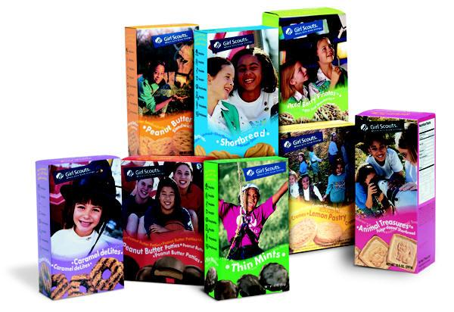
Did you ever stop eating a wonderful box of girl scout cookies and ask yourself what's it made out of? Two girl scouts Madison Vorva and Rhiannon Tomtishen had recently found out there delicious girl scout cookies have the terrible oil, Palm Oil. They were devastated to hear the news. The two Girl scouts spent seven whole years finding awareness to help find a way to make their girl scout cookies free of Palm Oil. These two girls believed they could do something, they were only in sixth grade. In a lot of cookies there are traces of palm oil.These two girls did not want to be reminded of the horrible things palm oil does. These girls wanted to make sure they would not hurt the environment any more.
And they did do something amazing-they helped the earth!!! They got
about 70,000 people to sign a contract to make girl scout cookies free from palm
oil. Now, some of the trees are being saved because of these 2 girl scouts. This shows
that these people were life savers and they have done a lot to many almost homeless
Orangutans. This that people can make a difference if they try to.

Slide 10
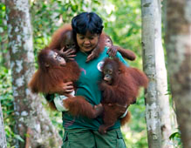
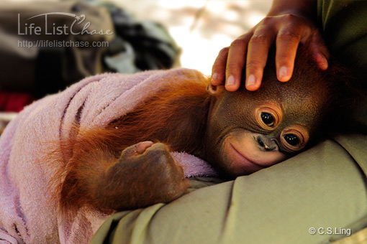
What can we do to save the Orangutans?
There are so many things that we could do to save the environment. We can start off by planting more trees. We can take good care of the orangutans by helping and nurturing these primates. We can also help by taking down products that need palm oil. We could also shut down companies that use palm oil for their products. There are many other ways to take care of orangutans. We can make sure that they are safe by checking on them so that they will not get into trouble.
We can also make sure that orangutans will live in a place where people do not cut down their trees. We can help by giving them a place to live and nurture them for a long time. We can make a place for them to play and get exercise. Many people work for places that take care of orangutans. The first thing that we could do is to stop cutting down trees for the useage of palm oil. We can also make sure that none of the products include palm oil. These are some examples of what we can do to help orangutans.

Slide 11
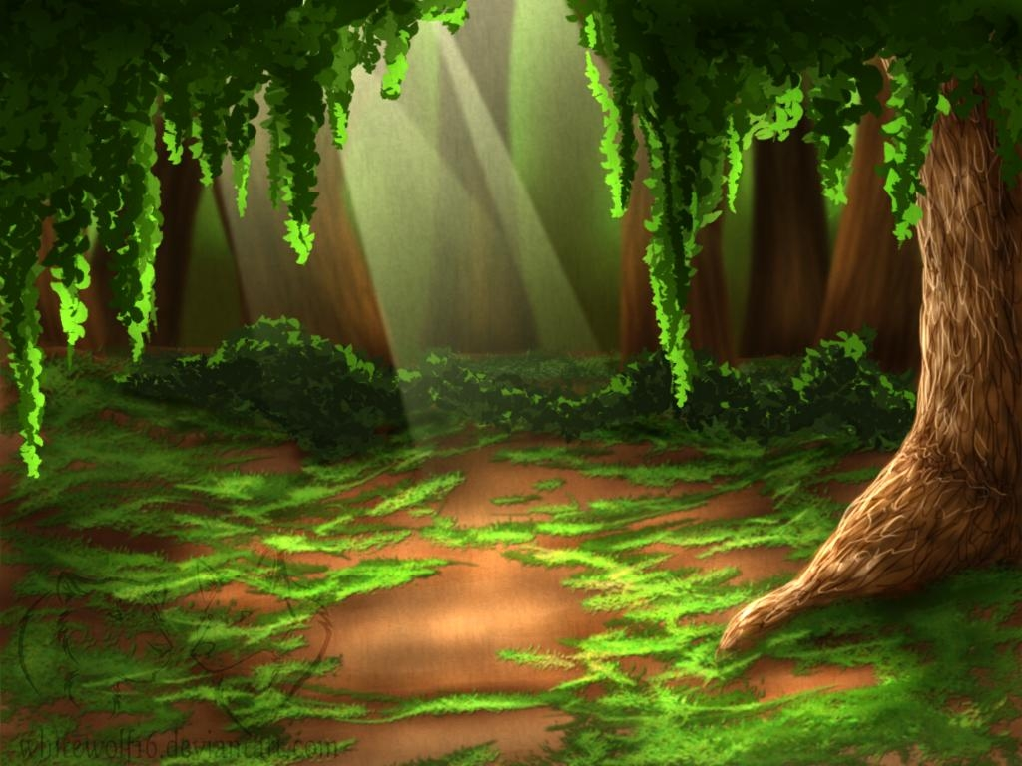
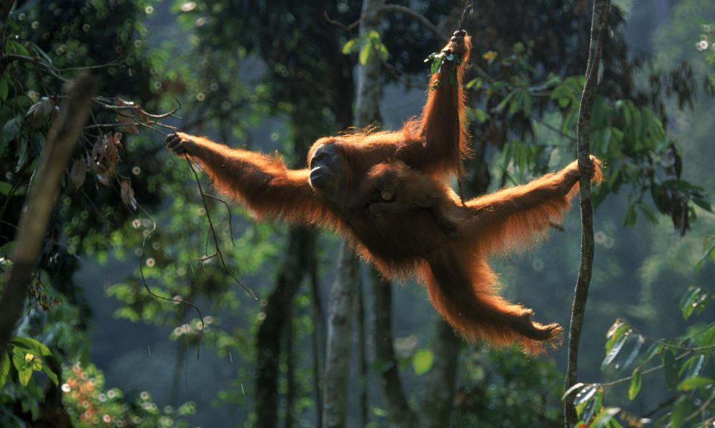
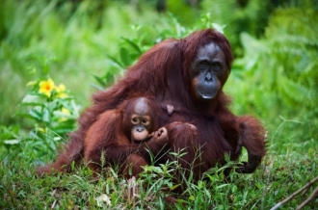
When we are protecting the orangutans, we don’t cut down the trees or make palm oil. We don’t buy products that have palm oil. According to humane ed, people would care more about the palm oil crisis and they would not be creating all of these problems. A long time ago, the orangutans created us. We were the next generation of those living creatures called humans. When we were created, it was all thanks to the orangutans. They helped us and we don’t help them. By helping them means to plant more palm trees and to not cut them down to make palm oil for our favorite products. If we stopped using palm oil, many lives will be saved and the orangutans would still be safe. The forests would be good for them to survive in. As we know, the orangutans need the palm trees for them to survive. People would be thanked by millions of lives by not only orangutans, but by humans also. Palm oil right now is still a big problem. But in the future things could become better. It all depends on us.

Slide 12
